Slide 1
Customer Lifetime Analysis on Amazon Prime Users

Slide 2
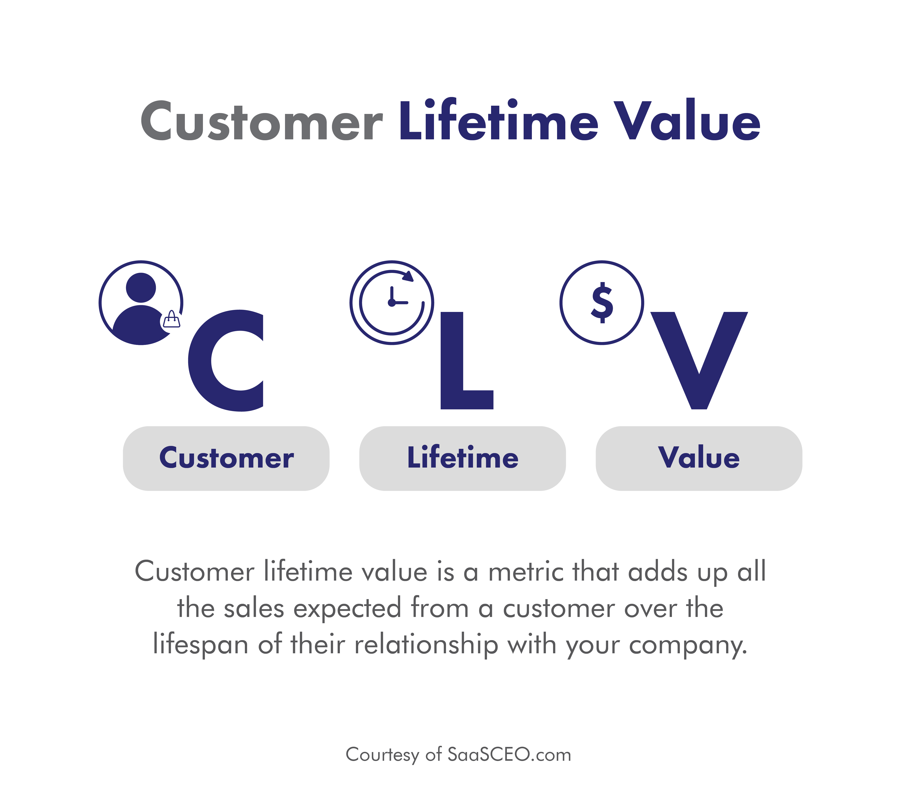
Project analysis slide 2
CLV ANALYSIS
Customer Lifetime Value (CLV) is a critical metric that measures the total revenue a business can reasonably expect from a customer over the entire duration of their relationship.

Slide 3

Project analysis slide 2
CLV ANALYSIS
For Amazon Prime users, understanding CLV is essential for optimizing customer retention strategies, pricing models, and marketing efforts. By analyzing CLV, Amazon can identify high-value customer segments, predict future revenue streams, and allocate resources more efficiently to maximize profitability.

Slide 4
Project analysis slide 2
DATA SET
Amazon Prime Users
2500 Observations
Each entry in the dataset includes 19 columns:
Categorical: user ID, name, email address, username, date of birth, gender, location, membership start date, membership end date, subscription plan, payment information, renewal status, usage frequency, purchase history, favorite genres, devices used, and engagement metrics.
Nominal: feedback/ratings, and customer support interactions.

Slide 5
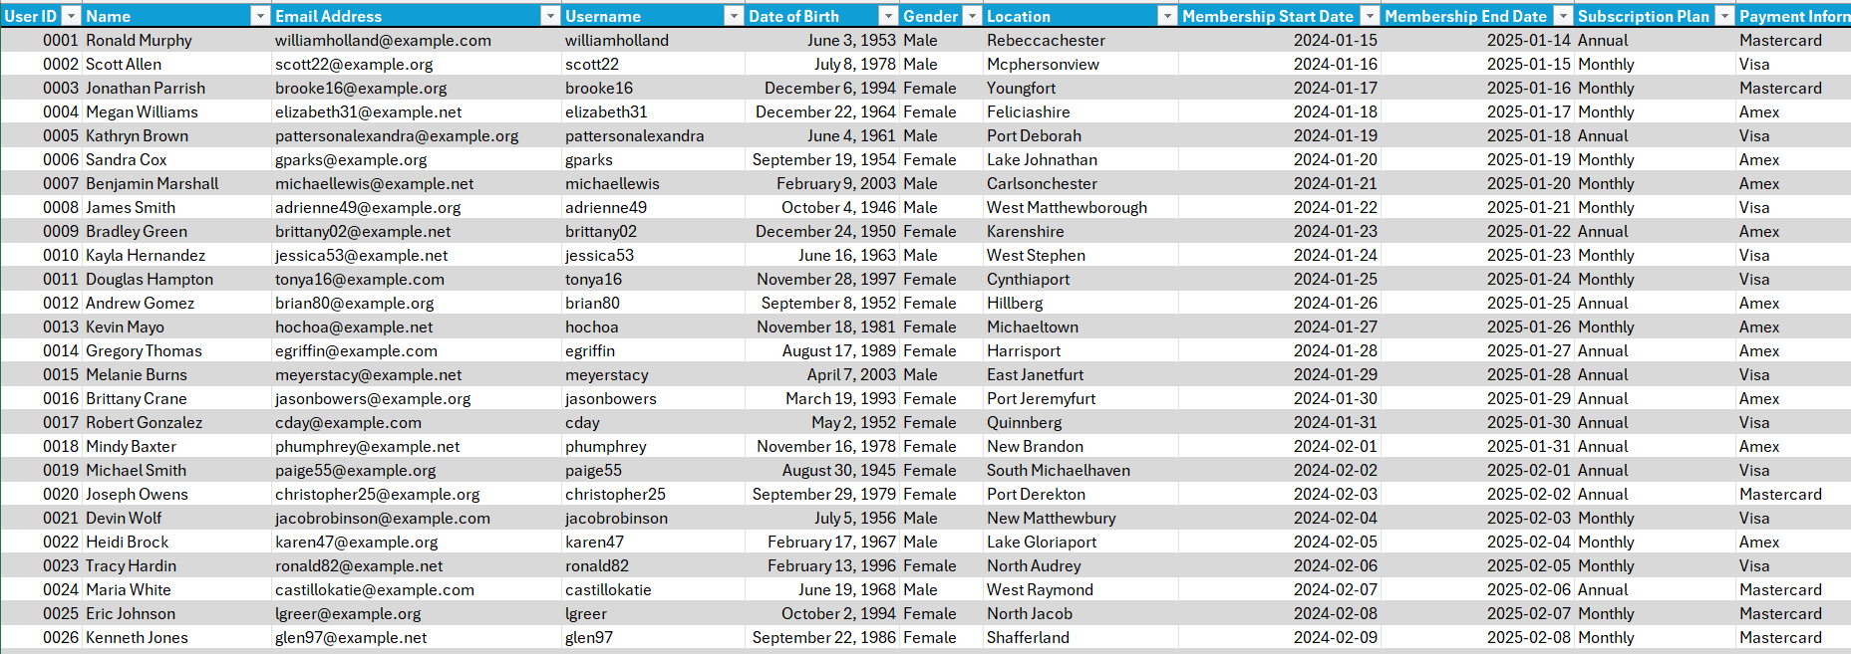
Project analysis slide 2
DATA SET

Slide 6
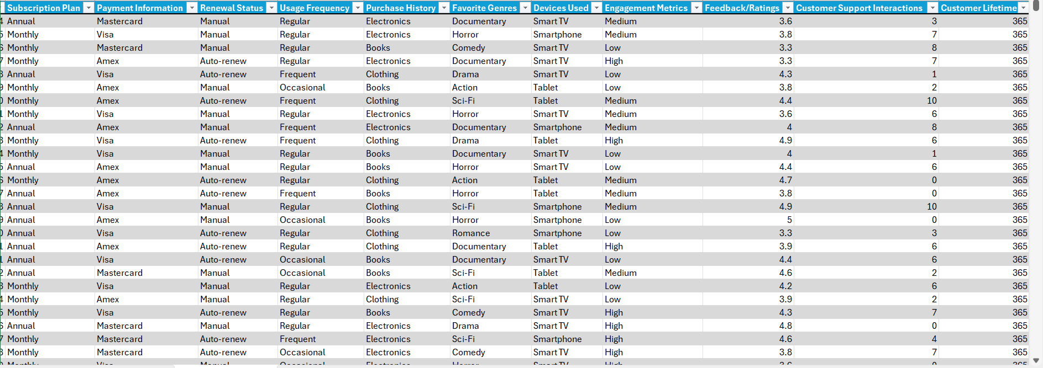
Project analysis slide 2
DATA SET

Slide 7
Project analysis slide 2
THE GOAL
The primary goals of this Customer Lifetime Value (CLV) analysis are:
Segment Customers
Optimize Marketing Spend
Improve Customer Retention

Slide 8
Project analysis slide 5
DASHBOARD

Slide 9
Project analysis slide 2
SEGMENT CUSTOMERS
High-Value Segments identified:
Female Users: We have identified the female demographic showing an overall higher CLV and customer retention rate than the males, with female users having a lower net decrease in CLV over the year, even though male user CLV spikes in the first quarter
Smartphone Users: Smartphone users were identified as having the highest CLV based on the devices used. Tablet users come second, and smart TV users come last.

Slide 10
Project analysis slide 2
SEGMENT CUSTOMERS
High-Value Segments identified:
Monthly Subscribers: Monthly subscribers have a higher CLV than annual subscribers.
Electronics Buyers: Of the three categories of products offered, Electronics buyers have the highest CLV but this is no surprise with electronics having higher prices than books and clothing
Genres: There are also top genres which include action, horror, documentary and romance to be focused on.

Slide 11
Project analysis slide 2
OPTIMIZE MARKET SPENDING
Concentration should be put on making responsive content and providing a seamless user experience regardless of the device being used.
Increasing electronics sales through warranty coverage or exclusive deals and promotions, and the second highest category, books.
More resources should be used to acquire and market content from these specific genres and launch marketing campaigns specifically tailored to promote the content.

Slide 12
Project analysis slide 2
IMPROVE CUSTOMER RETENTION
Content and advertising should be tailored to resonate more strongly with the female audience, while still catering to the preferences of male users.
Discounted introductory rates or bundle deals to attract more monthly subscribers, implement a loyalty program that rewards monthly subscribers for their continued patronage, and provide incentives for annual subscribers to upgrade their plans or renew their subscriptions early.

Slide 13
Project analysis slide 2
CONCLUSION
CLV analysis provided valuable insights into the behavior and value of Amazon Prime users over time. Key findings include the identification of high-value user segments, such as those who are frequent subscribers or exhibit high engagement levels. These insights are crucial for developing targeted marketing strategies, optimizing customer retention efforts, and maximizing overall revenue.

Slide 14
Thank You

